Slide 1
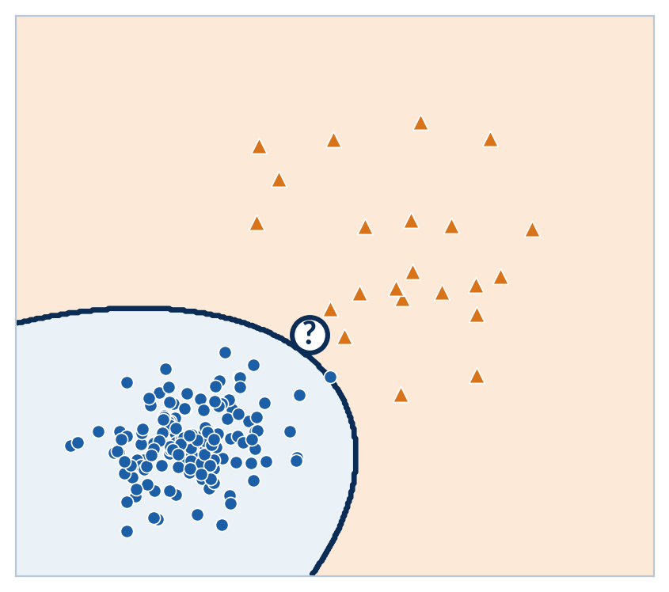

CompSci 471
Artificial Intelligence
Lesson 26: Machine Learning Foundations
A model earns trust on data it has never seen.
Features
Boundary
Test
Metric
Which side of the boundary does the new point fall on?
Fall 2026
Notes:
TIMING: 1 min (open, slides 1-3 total 4 min).
INSTRUCTOR: Open with the image. Every point on the right is a past card transaction: blue circles are legitimate, orange triangles are fraud. The curve is a boundary some model learned. Ask: "The white point just arrived. Which side is it on, and would you bet the customer's card on that answer?" Keep the answer open; the lesson is about how that boundary gets drawn (Part 4), whether we can trust it on new data (Part 2), and how we score it (Part 3). The four stage labels (Features, Boundary, Test, Metric) are the lesson's storyline.
CENTRAL CLAIM: A classifier is a learned decision boundary, and it earns trust only on data it has never seen.
ASSESSMENT ALIGNMENT: Framing only. [Confirm lesson placement and assessment timing against the syllabus when available.]

Slide 2
Retrieval warm-up
Our agents have planned from models and learned from rewards.
L05 | Search
L15 | Q-learning
L26 | Today
Given a map of the world, explore it systematically.
No map. Act, observe a reward, update an estimate.
Learn from past examples where the right answer is attached.
Learns from: a model
Learns from: a reward
Learns from: a label
What if we have thousands of past examples with the right answer already attached?
Turn and talk (60 s): name one system you use daily that learned from labeled examples.
CS 471 | L26: ML Foundations
2
Notes:
TIMING: 1.5 min.
INSTRUCTOR: Quick retrieval across the course arc. L05 search needed a complete model of the world (states, actions, costs). L15 Q-learning dropped the model and learned from reward signals, one sampled experience at a time. Today's agents learn from a third kind of signal: labeled examples, where someone already recorded the right answer. Ask the closing question, then run the 60-second turn-and-talk. Good student answers: spam filters, photo face grouping, music recommendations, fraud alerts on their own bank card, autocomplete.
CONNECTION: This is the "Understanding AI to Designing AI" pivot: students will soon be choosing and evaluating models, not just using them.
ASSESSMENT ALIGNMENT: Supports Objective 1 (supervised vs. other learning paradigms). [Confirm against GR/quiz items when available.]

Slide 3
Today’s mission
By the end of Lesson 26, you should be able to…
1
Distinguish supervised from unsupervised learning, and diagnose under- and overfitting from train/test results.
2
Evaluate a classifier with a confusion matrix (accuracy, precision, recall, F1), matched to the cost of each error.
3
Compare logistic regression, LDA/QDA, SVM, and trees/forests by assumption and boundary shape, and compute each model’s core quantity.
Performance target: given a classifier’s results, compute its metrics, diagnose whether it generalizes, and justify which model family fits the data.
CS 471 | L26: ML Foundations
3
Notes:
TIMING: 1.5 min.
INSTRUCTOR: Read the three objectives quickly and point to the performance target: that is what students should be able to do on their own by the end of class. Objective 1 = Part 2 (generalization), Objective 2 = Part 3 (metrics), Objective 3 = Part 4 (model families).
DESIGN NOTE: The source lesson listed four objectives. "Apply statistical ML models" was folded into Objective 3 at the level of assumption, boundary shape, and one core computation per model, which is realistic for 53 minutes.
ASSESSMENT ALIGNMENT: Objectives 1-3 map to the lesson's Knowledge Check (Q1 generalization/overfitting, Q2 model choice, Q3 bagging). [Map each objective to specific GR, quiz, Blackboard homework, and notebook items when available.]

Slide 4
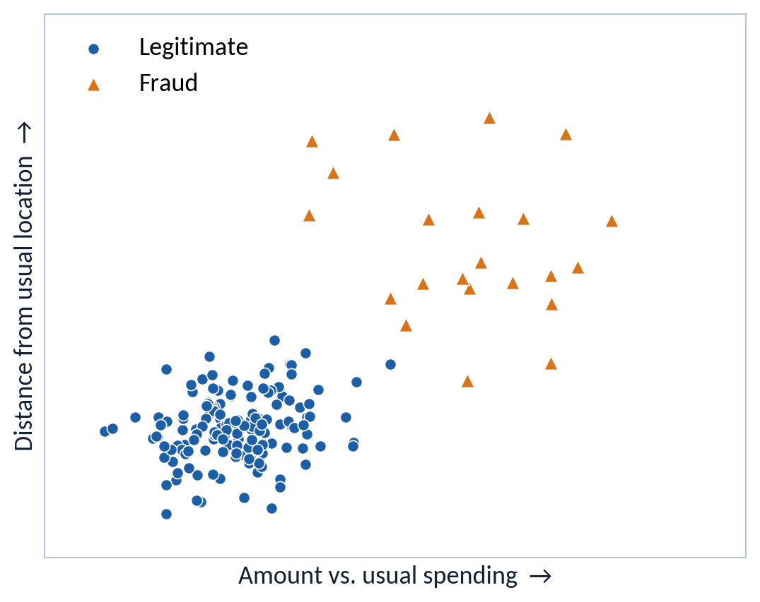
Running scenario: catch card fraud
A bank wants a model that flags fraud before the charge clears.
Mission setup
5,000 labeled historical transactions
Features: amount vs. usual spending; distance from usual location
Label: fraud or legitimate
Positive class = fraud
About 4% of transactions are fraud
What would a lazy model predict for every transaction?
Plotted sample oversamples fraud so it is visible.
CS 471 | L26: ML Foundations
4
Notes:
TIMING: 2 min (Part 1 total 5 min).
INSTRUCTOR: Introduce the running dataset. Every model today will be drawn on this exact plot, so spend a moment orienting: x axis = how unusual the amount is for this customer; y axis = how far from their usual location. Legit purchases cluster low and tight (people are predictable); fraud is spread out and far from normal. Point out the class imbalance: about 4% fraud. Ask the lazy-model question and let it hang; it pays off on slide 13 (the accuracy trap).
NOTE: The plotted sample oversamples fraud so students can see it; the full dataset is about 4% fraud.
VOCABULARY: features (inputs), label (answer), positive class (the thing we are trying to detect; here, fraud).
ASSESSMENT ALIGNMENT: Establishes vocabulary (features, labels, positive class) used in Objective 2 metrics. [Confirm against GR/quiz items when available.]

Slide 5
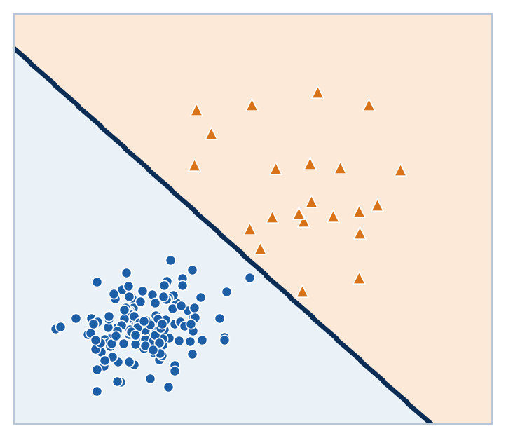
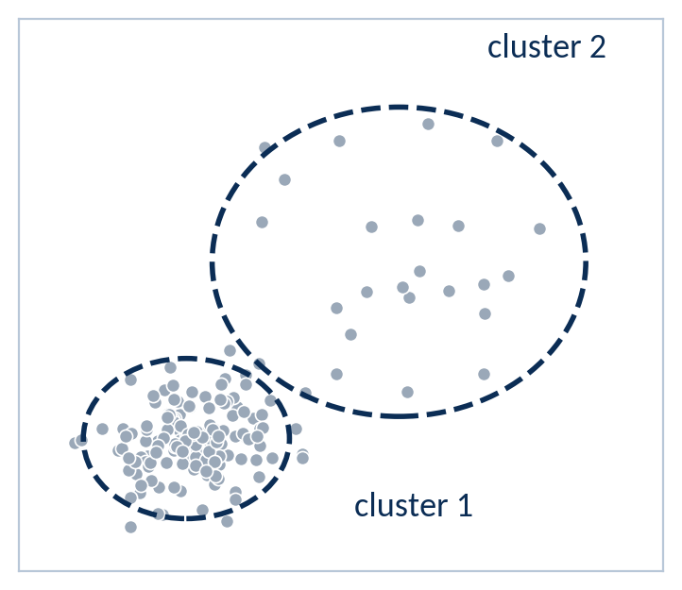
Supervised vs. unsupervised learning
The difference is whether the data comes with an answer key.
Supervised: labels included
Unsupervised: no labels
Reinforcement learning
(L13-L15)
No answer key and no fixed dataset.
The agent acts, then receives a reward signal.
Learn a boundary that predicts the label.
Find structure (clusters) in the data.
Labels are the difference. Today: supervised classification.
CS 471 | L26: ML Foundations
5
Notes:
TIMING: 2 min.
INSTRUCTOR: Same points, two situations. Left: every transaction has a label, so the algorithm can learn a boundary that predicts the label for new points (supervised: a student with an answer key). Right: the same data with the labels stripped away; the algorithm can only find structure, such as two clusters. It cannot tell you which cluster is "fraud"; a human has to interpret that. Name k-means as a common clustering method, but do not teach it today.
Third card: RL (L13-L15) is neither. There is no answer key and no fixed dataset; the agent gets a reward after acting.
MILITARY/ENGINEERING EXAMPLE (verbal): A squadron has thousands of unlabeled drone telemetry logs. Clustering can group similar flights so analysts triage the odd cluster first; once analysts label some flights as "fault" vs. "normal," the problem becomes supervised.
ASSESSMENT ALIGNMENT: Objective 1 (distinguish supervised and unsupervised). [Confirm against GR/quiz items when available.]

Slide 6
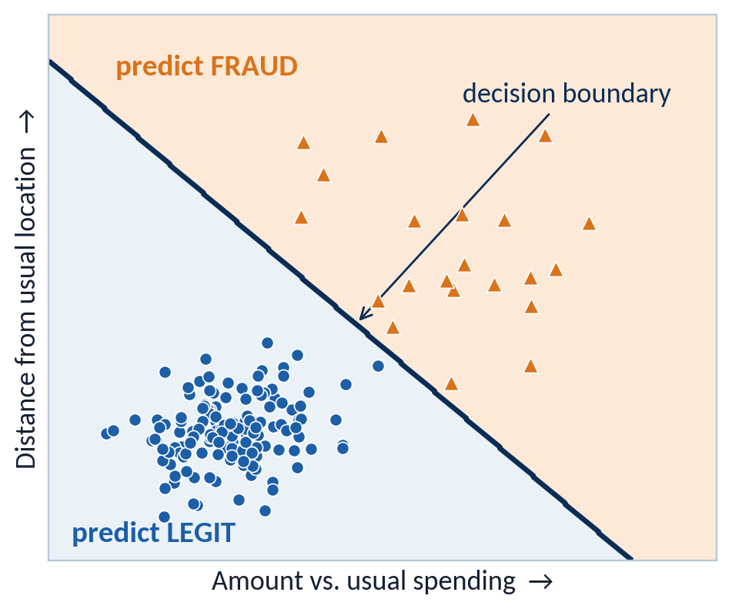
A classifier learns a decision boundary
Training turns labeled examples into a rule that splits the feature space.
Features x
amount, distance
Model f̂
learned from labeled data
Prediction ŷ
fraud or legit
Every model today is a different way to draw this boundary.
CS 471 | L26: ML Foundations
6
Notes:
TIMING: 1 min.
INSTRUCTOR: Lock in the vocabulary that the rest of the lesson hangs on. A trained model f-hat takes features x and outputs a prediction y-hat. Geometrically, it splits the feature space into a "predict fraud" region and a "predict legit" region; the dividing line is the decision boundary. Tell students: "Every model in Part 4 is just a different way to draw this line. This particular boundary happens to be logistic regression; we will see why it is straight."
MISCONCEPTION: Students sometimes think the model stores the training points. Most models here keep only the boundary's parameters (a few numbers), which is why they can score new points instantly.
ASSESSMENT ALIGNMENT: Foundation for Objective 3 (boundary shape per model). [Confirm against GR/quiz items when available.]

Slide 7



Memorizing is not learning
Scoring 100% on the answer key you studied proves nothing.
Training set 80%
the model studies these examples
Test set 20%
locked until the end
The memorizer
The learner
Studied the answer key.
100% on the practice exam.
Lost on new questions.
Learned the underlying pattern.
Slightly lower on practice.
Holds up on new questions.
Generalization = performance on data the model has never seen.
The test set is used once, at the end.
CS 471 | L26: ML Foundations
7
Notes:
TIMING: 1.5 min (Part 2 total 10 min).
INSTRUCTOR: If a model is scored on the same examples it trained on, a big enough model can simply memorize them and score 100%. That tells us nothing about new transactions tomorrow. So before training we split the data: the model studies the training set (commonly about 80%) and the test set (about 20%) is locked away until the final evaluation. Use the exam analogy: memorizing last year's practice exam answers vs. understanding the material.
VALIDATION SET (say in one sentence): If you need to tune settings or compare models, carve a separate validation set out of the training data; peeking at the test set to tune makes the final test score optimistic.
ASSESSMENT ALIGNMENT: Objective 1 (train/test split, generalization); Knowledge Check Q1. [Confirm against GR/quiz/notebook items when available.]

Slide 8
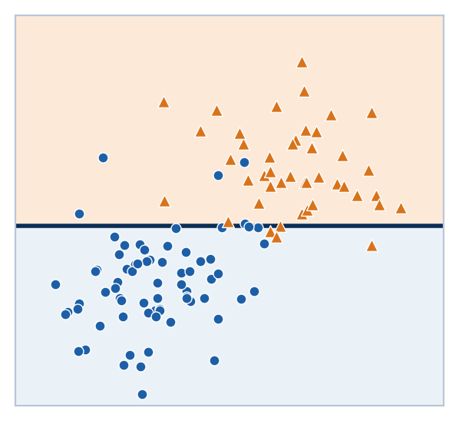
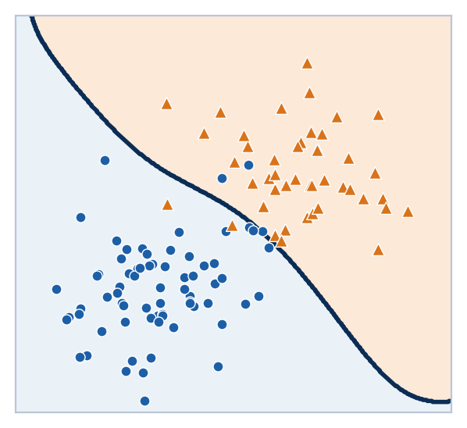
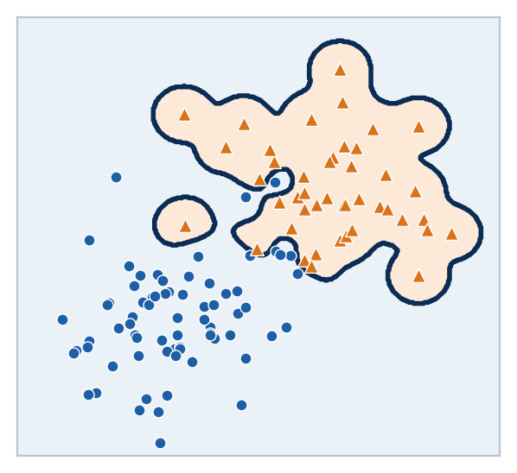
Three fits, same data
Flexibility helps until the model starts fitting noise.
High bias | underfit
Balanced
High variance | overfit
Train error: high
Test error: high
Train error: low
Test error: low
Train error: near 0
Test error: high
Which boundary would change most if we collected a new sample?
CS 471 | L26: ML Foundations
8
Notes:
TIMING: 2 min.
INSTRUCTOR: Same training data, three models of increasing flexibility.
Left (high bias / underfit): a single rigid cut. It misses the real shape, so it is wrong on training AND test data.
Middle (balanced): a smooth curve that follows the real trend and ignores stray points.
Right (high variance / overfit): the boundary bends around individual points, drawing little islands around outliers. Training error near zero, but those islands are noise, so test error is high.
Ask the takeaway question. Answer: the right panel. A new sample would put the outliers in different places, and the islands would move. That sensitivity to the particular sample IS variance (defined on the next slide).
FIGURE NOTE: Real fitted boundaries (a one-split tree, a smooth RBF SVM, and a very high-gamma RBF SVM). The right panel is a good preview of backup slide B3 on kernels.
ASSESSMENT ALIGNMENT: Objective 1 (identify under/overfitting); Knowledge Check Q1. [Confirm against GR/quiz items when available.]

Slide 9
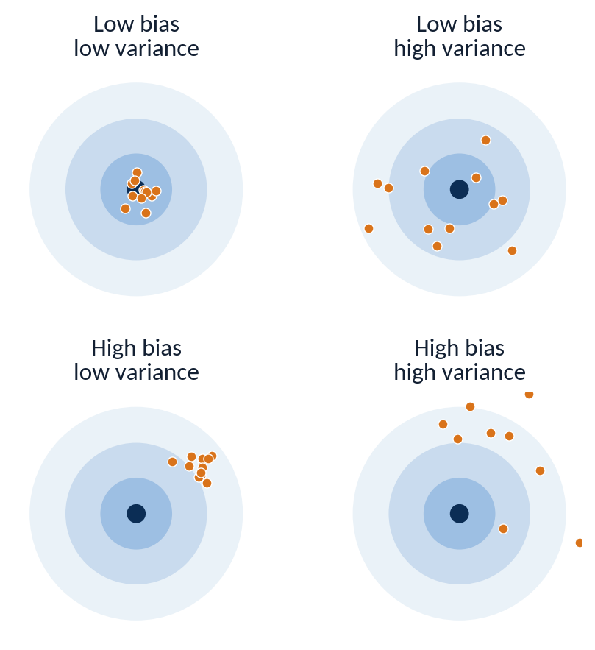
Where prediction error comes from
Expected error splits into three parts, and only two are yours to control.
Expected error = Bias² + Variance + σ²
Bias²
Error from wrong assumptions: a straight line trying to fit a curve. Leads to underfitting.
Variance
Error from sensitivity to the particular training sample. Leads to overfitting.
σ² (irreducible)
Noise in the data itself: an honest customer who really is traveling looks like fraud.
Only bias and variance are yours to control.
CS 471 | L26: ML Foundations
9
Notes:
TIMING: 2 min.
INSTRUCTOR: Read the equation left to right as "wrong on average" + "unstable across samples" + "noise nobody can remove."
Dartboards: imagine retraining the model on many different training samples and plotting where each version's prediction lands. Bias = how far the average shot is from the bullseye. Variance = how scattered the shots are.
Irreducible error in fraud terms: an honest customer who genuinely is traveling and buying something expensive looks exactly like fraud in these two features. No model using only these features can separate them.
MISCONCEPTION: "A better algorithm can drive error to zero." No: sigma-squared is a floor set by the data and features. Only new, more informative features can lower it.
SOURCE NOTE: Decomposition as in James et al. (2023), ISL, p. 31.
ASSESSMENT ALIGNMENT: Objective 1 (bias-variance tradeoff). [Confirm against GR/quiz items when available.]

Slide 10
Worked example: sweep model complexity
Compute → Interpret → Predict: total error = bias² + variance + σ².
Model | Bias² | Variance | σ² | Total
Simple | 9 | 1 | 3 | 13
Moderate | 3 | 2 | 3 | 8
Very flexible | 0.5 | 9.5 | 3 | 13
σ² = 3 for every model: no model can remove it.
Compute
Interpret
Predict
Add the three terms for each model: 13, 8, and 13.
The extremes tie for opposite reasons. Moderate flexibility is the sweet spot.
Even more flexibility? Variance keeps growing, so total error rises.
CS 471 | L26: ML Foundations
10
Notes:
TIMING: 2.5 min.
INSTRUCTOR: Three candidate fraud models, same data, sigma-squared = 3 for all (the noise floor does not depend on the model).
COMPUTE: Simple 9 + 1 + 3 = 13. Moderate 3 + 2 + 3 = 8. Very flexible 0.5 + 9.5 + 3 = 13.
INTERPRET: The two extremes tie at 13 for opposite reasons: the simple model is wrong on average (bias), the flexible model is unstable (variance). The moderate model is the sweet spot. Point to the chart: bias falls and variance rises as flexibility grows; total error is U-shaped.
PREDICT: Ask "What happens if we make the model even more flexible than the rightmost one?" Variance keeps growing faster than bias can shrink (bias is already near 0), so total error rises further. Also ask: can any model get below 3? No.
NOTE: Numbers are illustrative and intentionally different from the reading's example.
ASSESSMENT ALIGNMENT: Objective 1; Compute-Interpret-Predict practice with the decomposition. [Confirm against GR/quiz/homework items when available.]

Slide 11
Diagnose from train vs. test
The gap between training and testing performance tells the story.
Model | Train accuracy | Test accuracy | Gap | Diagnosis
A | 99% | 71% | 28 pts
B | 88% | 86% | 2 pts
C | 70% | 69% | 1 pt
Overfit
Underfit
Generalizes
Rule of thumb: big gap → high variance (overfit) | both low and close → high bias (underfit) | both high and close → generalizes
A drone motor-fault model scores 97% in the lab and 64% on the flight line. Diagnosis?
CS 471 | L26: ML Foundations
11
Notes:
TIMING: 2 min.
INSTRUCTOR: Pairs, 60 seconds: fill in the Diagnosis column using the rule card. Then reveal.
ANSWERS: Model A (99% / 71%, 28-point gap) = overfit, high variance: it memorized the training data. Model B (88% / 86%) = generalizes well. Model C (70% / 69%) = underfit, high bias: close together, but both poor, so the model is too simple.
Drone card answer: overfit (high variance). A 33-point drop from lab to flight line means the model learned lab-specific quirks.
WATCH FOR: Students picking Model A because it has the highest number. Ask "which number predicts tomorrow's performance?" (the test number).
CAUTION: The rule of thumb assumes the test set is representative. If the flight-line data differs systematically from lab data (distribution shift), a gap can also mean the test conditions changed; mention only if a student raises it.
ASSESSMENT ALIGNMENT: Objective 1; directly practices Knowledge Check Q1 with different numbers. [Confirm against GR/quiz items when available.]

Slide 12
Match the fix to the failure
Underfitting and overfitting need opposite treatments.
High variance (overfit)
High bias (underfit)
Symptom: big train/test gap
Symptom: train and test both poor
Levers that help:
Levers that help:
More training data
Simpler or more constrained model
Average many models (random forest, later today)
Richer, more informative features
A more flexible model
Fewer restrictions on the model
Which problem does “collect more data” mainly fix?
CS 471 | L26: ML Foundations
12
Notes:
TIMING: 1.5 min.
INSTRUCTOR: The payoff of a diagnosis is choosing the right lever.
High variance: more training data (harder to memorize a larger sample), a simpler or more constrained model, fewer noisy features, or averaging many models (random forest; foreshadow slide 30).
High bias: give the model better information (richer features) or more flexibility.
Ask the question. Answer: mainly high variance. More data does little for a model that is too simple; a straight line stays a straight line no matter how many points you give it.
MISCONCEPTION: "More data always helps." It helps variance problems; it barely touches bias problems.
ASSESSMENT ALIGNMENT: Objective 1 (bias-variance reasoning); sets up Knowledge Check Q3 (bagging reduces variance). [Confirm against GR/quiz items when available.]

Slide 13
The accuracy trap
A model can look excellent while doing nothing useful.
96%
accuracy
0 of 40
fraud cases caught
The lazy model
Test set: 1,000 transactions, 40 fraud
Rule: predict LEGIT for everything
Correct on all 960 legit
960 / 1,000 = 96%
96% accurate. 0% useful.
CS 471 | L26: ML Foundations
13
Notes:
TIMING: 1.5 min (Part 3 total 10 min).
INSTRUCTOR: Pay off the slide 4 question. The laziest possible fraud model predicts "legit" for every transaction. On a test set of 1,000 transactions with 40 fraud, it is right on all 960 legit ones: 960 / 1,000 = 96% accuracy. It catches zero fraud. Whenever the positive class is rare, accuracy is dominated by the easy majority class.
ASK: "What single number would have exposed this model immediately?" (Fraud caught out of fraud present: that is recall, next two slides.)
MILITARY/ENGINEERING PARALLEL (verbal): Any rare-event detector has this problem: intrusion alerts in network logs, rare targets in satellite imagery, impending component failures in fleet telemetry.
ASSESSMENT ALIGNMENT: Objective 2 (why accuracy misleads under class imbalance). [Confirm against GR/quiz items when available.]

Slide 14
The confusion matrix
Split predictions by what the model said and what was actually true.
Predicted: FRAUD
Predicted: LEGIT
Reading the matrix
Actual:
FRAUD
TP
Fraud caught
FN
Fraud missed
(chargeback)
Rows = what was actually true
Columns = what the model said
Diagonal (green) = correct
Off-diagonal (red) = the two kinds of error
“Positive” = predicted fraud, not “good news”
Actual:
LEGIT
FP
Honest card blocked
TN
Normal purchase approved
Two kinds of error. Two very different costs.
CS 471 | L26: ML Foundations
14
Notes:
TIMING: 2 min.
INSTRUCTOR: Build the matrix out loud. Columns = what the model predicted; rows = what was actually true. The diagonal (green) is correct; the off-diagonal (red) are the two kinds of error, and in fraud they have very different costs:
False positive: an honest customer's card is declined at the grocery store (annoyance, lost customer trust).
False negative: fraud goes through (money lost, chargeback).
Emphasize "positive" means "the model said fraud," not "good news."
MILITARY/ENGINEERING PARALLEL: Target detection in satellite imagery maps the same way: TP = real target found; FP = a decoy or civilian structure flagged (wasted analyst time or worse); FN = a real target missed; TN = empty terrain correctly ignored. Ask which error is costlier there.
SOURCE NOTE: Powers (2011) for metric definitions.
ASSESSMENT ALIGNMENT: Objective 2 (confusion matrix interpretation). [Confirm against GR/quiz items when available.]

Slide 15
Three questions, three metrics
Each metric answers a different operational question.
Precision
Recall
F1 score
When it flags fraud, is it right?
Of all real fraud, how much did it catch?
One number that balances both
TP / (TP + FP)
TP / (TP + FN)
2 × P × R / (P + R)
TP
FN
TP
FN
TP
FN
FP
TN
FP
TN
FP
TN
“Predicted fraud” column
“Actual fraud” row
Never uses TN
None of these metrics rewards the easy true negatives.
CS 471 | L26: ML Foundations
15
Notes:
TIMING: 2 min.
INSTRUCTOR: Tie each formula to the highlighted cells so students stop memorizing and start reading the matrix.
Precision uses the "Predicted FRAUD" column: of everything we flagged, how much was really fraud? Matters when false alarms are expensive.
Recall uses the "Actual FRAUD" row: of all real fraud, how much did we catch? Matters when misses are expensive.
F1 is the harmonic mean: it is high only when BOTH are reasonably high, so a model cannot hide a terrible recall behind a great precision.
KEY INSIGHT: None of the three uses TN, which is exactly the huge, easy cell that inflated accuracy on the last slide. Quick check: what is the lazy model's recall? 0 / 40 = 0.
ASSESSMENT ALIGNMENT: Objective 2 (compute precision, recall, F1). [Confirm against GR/quiz/homework items when available.]

Slide 16
Worked example: score a real fraud model
Same 1,000-transaction test set, with a model that actually tries.
Predicted: FRAUD
Predicted: LEGIT
Metric | Calculation | Value
Accuracy | (30 + 940) / 1,000 | 0.97
Precision | 30 / (30 + 20) | 0.60
Recall | 30 / (30 + 10) | 0.75
F1 | 2(0.60)(0.75) / 1.35 | 0.67
Actual:
FRAUD
TP
30
FN
10
Actual:
LEGIT
FP
20
TN
940
Interpret: 97% sounds great, yet 1 in 4 frauds slips through, and 2 of every 5 alerts block an honest customer.
CS 471 | L26: ML Foundations
16
Notes:
TIMING: 2.5 min.
INSTRUCTOR: Compute together, one row at a time. Have students predict before revealing each value.
Accuracy = (30 + 940) / 1,000 = 0.97.
Precision = 30 / (30 + 20) = 0.60.
Recall = 30 / (30 + 10) = 0.75.
F1 = 2(0.60)(0.75) / (0.60 + 0.75) = 0.90 / 1.35 = about 0.67.
INTERPRET: Only one point better than the lazy model on accuracy, but enormously more useful. Still: 10 of 40 frauds slip through (recall 0.75), and 20 of 50 alerts block an honest customer (precision 0.60). Whether that is acceptable is a business or mission decision, not a math one.
WATCH FOR: Students swapping FP and FN in the denominators. Anchor: precision = "of what we flagged" (column); recall = "of what was really there" (row).
ASSESSMENT ALIGNMENT: Objective 2 (compute and interpret metrics). Numbers are original to this deck. [Confirm against GR/quiz/homework items when available.]

Slide 17
Predict: move the threshold
Flagging less often trades one error type for the other.
Model’s predicted probability of fraud
0.0
1.0
threshold = 0.5
Lower it (flag more often)
Precision ↓ Recall ↑
Raise it (flag less often)
Precision ↑ Recall ↓
Which metric would you prioritize?
(a) Spam filter: a real email lands in the spam folder and is never read.
(b) Malware detector on a flight-control computer: a miss could ground or lose the aircraft.
CS 471 | L26: ML Foundations
17
Notes:
TIMING: 2 min.
INSTRUCTOR: Most classifiers output a probability; a threshold turns it into a decision (default 0.5). Moving the threshold does not retrain the model, it only changes how cautious the model is.
Raise the threshold: the model flags only very confident cases, so the flags it makes are more often right (precision up), but it misses more fraud (recall down).
Lower the threshold: the reverse.
Scenario answers:
(a) Spam filter: prioritize PRECISION. A false positive sends a real email (a job offer) to the spam folder where no one sees it; a missed spam is a mild annoyance.
(b) Malware detector on a flight-control computer: prioritize RECALL. A miss could be catastrophic; a false alarm costs an inspection.
Push: "Would you ever pick F1 instead?" When both errors matter comparably, or you need one number to compare models.
CONNECTION: This threshold is exactly the "P > 0.5" in logistic regression, coming next.
ASSESSMENT ALIGNMENT: Objective 2 (choose the metric that matches error cost). [Confirm against GR/quiz items when available.]

Slide 18
Practice: phishing email detector
Compute first. Then decide whether you would deploy it.
500 emails | 20 are phishing | positive class = phishing
Accuracy =
(18 + 474) / 500 = 0.984
Predicted: PHISH
Predicted: SAFE
Actual:
PHISH
TP
18
FN
2
Precision =
18 / (18 + 6) = 0.75
Recall =
18 / (18 + 2) = 0.90
Actual:
SAFE
FP
6
TN
474
F1 =
2(0.75)(0.90) / (0.75 + 0.90) = 1.35 / 1.65 = ~ 0.82
Would you deploy it? Justify with the metric that matches the cost.
CS 471 | L26: ML Foundations
18
Notes:
TIMING: 2 min (pairs). If short on time, assign as homework.
ANSWERS (do not show until pairs finish):
Accuracy = (18 + 474) / 500 = 0.984.
Precision = 18 / (18 + 6) = 0.75.
Recall = 18 / (18 + 2) = 0.90.
F1 = 2(0.75)(0.90) / (0.75 + 0.90) = 1.35 / 1.65 = about 0.82.
Deployment discussion: It catches 90% of phishing, and 1 in 4 quarantined emails is legitimate. For an organization's mail gateway, a reasonable answer is "deploy with a quarantine folder users can review," which lowers the cost of false positives. The key is that students justify using the metric tied to the cost they care about.
WATCH FOR: Students reporting 98.4% accuracy as the headline. Ask: what would the "never phishing" model score? (480/500 = 96%.)
ASSESSMENT ALIGNMENT: Objective 2 (independent practice: compute and interpret). Original numbers. [Confirm against GR/quiz/homework items when available.]

Slide 19
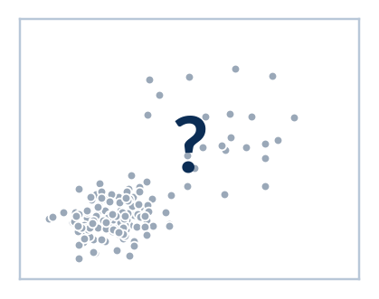
Five ways to draw the boundary
Same data, five model families. Each makes a different assumption – we will complete this table.
Model | Boundary | Key assumption | Boundary shape | Bias / variance lean
Logistic regression |  | ? | ? | ?
LDA |  | ? | ? | ?
QDA |  | ? | ? | ?
SVM |  | ? | ? | ?
Trees & random forests |  | ? | ? | ?
CS 471 | L26: ML Foundations
19
Notes:
TIMING: 1 min (Part 4 total 20 min).
INSTRUCTOR: This is the roadmap for Part 4 and the organizer students should copy into their notes. Each row gets filled in as we go; slide 31 shows it completed on the same fraud data. Frame the whole section with one question per model: "What does this model assume about the data, and what shape of boundary does that assumption produce?"
CONNECTION: The last column ties every model back to Part 2's bias-variance tradeoff.
ASSESSMENT ALIGNMENT: Objective 3 (compare model families). Knowledge Check Q2 (why choose a kernel SVM over logistic regression) is answered by comparing the "boundary shape" column. [Confirm against GR/quiz/notebook items when available.]

Slide 20
Logistic regression: a line, then a probability
Regression in name, classifier in practice.
1 Linear score
z = β₀ + β₁x₁ + … + βₙxₙ
2 Sigmoid
P = 1 / (1 + e⁻ᶻ)
3 Threshold
P > 0.5 → flag fraud
1
z can be any number; the sigmoid squashes it into 0 to 1.
2
z = 0 gives P = 0.5. That line is the decision boundary.
3
A positive β means the feature pushes toward fraud; a bigger β pushes harder.
Slide 6’s boundary was logistic regression.
CS 471 | L26: ML Foundations
20
Notes:
TIMING: 1.5 min.
INSTRUCTOR: Walk the pipeline left to right. Step 1 is ordinary linear regression: a weighted sum of features, z, which can be any number. Step 2 squashes z through the sigmoid into a probability between 0 and 1. Step 3 applies the threshold from slide 17.
Why the boundary is a straight line: P = 0.5 exactly where z = 0, and z = 0 is a linear equation in the features. Point to the right figure: slide 6's boundary was logistic regression.
Name trap: despite "regression," it is a classification method (it models the probability of a class).
SOURCE NOTE: James et al. (2023), ISL, p. 138.
ASSESSMENT ALIGNMENT: Objective 3 (logistic regression mechanism and boundary). [Confirm against GR/quiz/notebook items when available.]

Slide 21
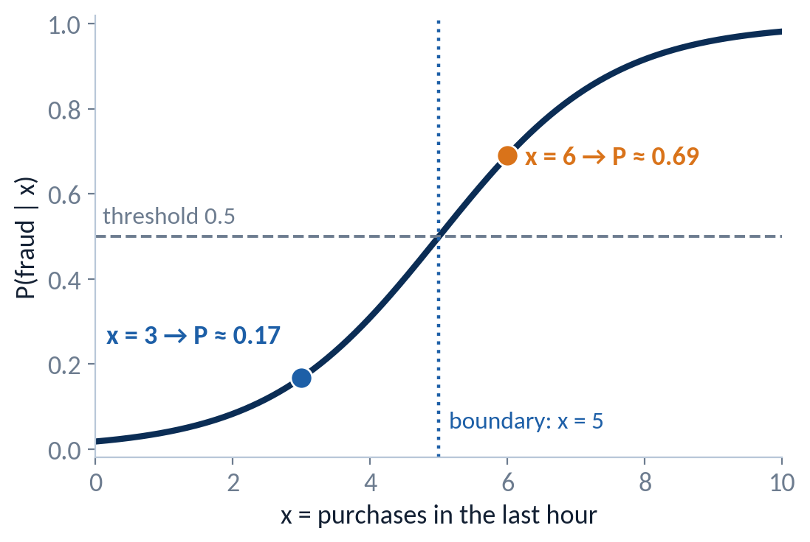
Worked example: logistic regression
One feature: x = card purchases in the last hour. Trained weights: β₀ = −4, β₁ = 0.8.
Compute
x = 6: z = −4 + 0.8(6) = 0.8
P = 1 / (1 + e⁻⁰·⁸) = 1 / 1.449 ≈ 0.69 → flag
x = 3: z = −4 + 0.8(3) = −1.6
P = 1 / (1 + e¹·⁶) = 1 / 5.95 ≈ 0.17 → approve
Interpret
β₁ > 0: each extra purchase per hour raises the fraud probability.
Predict
Where is P = 0.5? Where z = 0: −4 + 0.8x = 0, so x = 5.
CS 471 | L26: ML Foundations
21
Notes:
TIMING: 2.5 min.
INSTRUCTOR:
COMPUTE (x = 6): z = -4 + 0.8(6) = 0.8. e^(-0.8) is about 0.449, so P = 1 / 1.449, about 0.69. Above 0.5, so flag.
COMPUTE (x = 3): z = -4 + 0.8(3) = -1.6. e^(1.6) is about 4.95, so P = 1 / 5.95, about 0.17. Approve.
Show both points on the S-curve.
INTERPRET: beta-1 is positive, so more purchases per hour means higher fraud probability. The curve is steepest near the boundary: that is where each extra purchase changes the probability most.
PREDICT: Where is P exactly 0.5? Where z = 0: -4 + 0.8x = 0, so x = 5. Every card with more than 5 purchases in an hour gets flagged. Follow-up: "If the bank raised the threshold to 0.9, would the cutoff move left or right?" (Right: the model needs more evidence.)
CALCULATOR NOTE: Students may need e^x on a calculator; give 0.449 and 4.95 if needed so the focus stays on interpretation.
ASSESSMENT ALIGNMENT: Objective 3 (compute a logistic probability and locate the boundary). Original numbers. [Confirm against GR/quiz/homework items when available.]

Slide 22
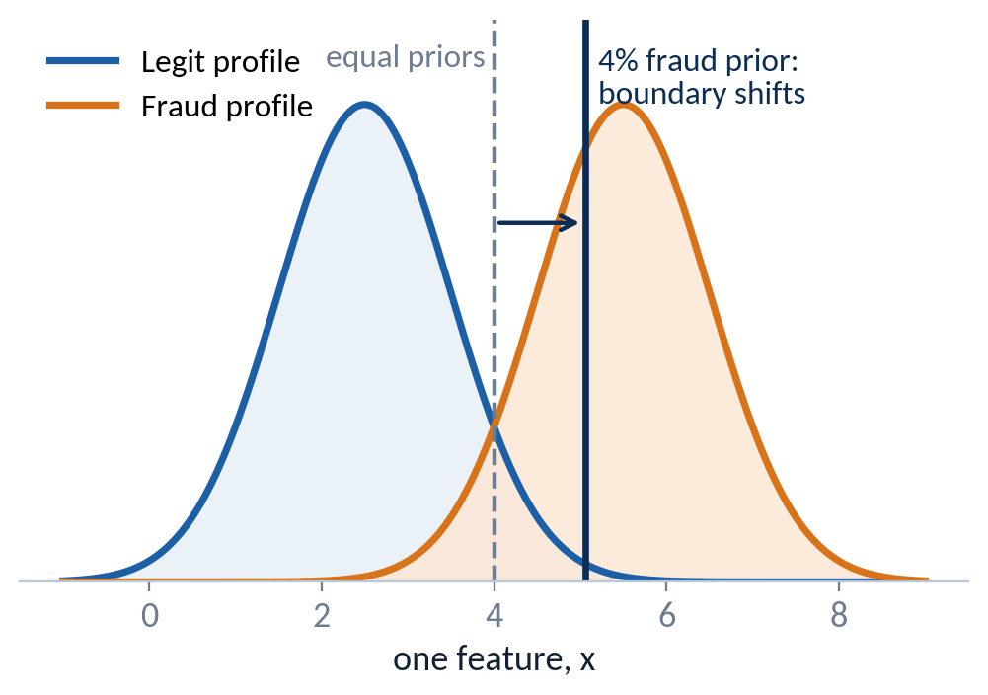
LDA: model what each class looks like
Build a profile for each class, then ask which profile better explains the new point.
1
Profile each class: a bell curve with its own mean.
2
Assume every class shares the same spread (variance).
3
Weight each profile by how common the class is (prior π).
4
Bayes’ rule: pick the class with the larger prior × likelihood.
P(fraud | x) =
π_{fraud} f_{fraud}(x) / [ π_{fraud} f_{fraud}(x) + π_{legit} f_{legit}(x) ]
Shared spread → the boundary is a straight line.
CS 471 | L26: ML Foundations
22
Notes:
TIMING: 1.5 min.
INSTRUCTOR: Logistic regression models the probability directly. LDA works the other way around: it models what each class's feature values look like (a bell curve per class), then uses Bayes' rule to flip that into "which class is this point most likely from?"
The key LDA assumption: all classes share the same spread (variance). With equal spreads, the boundary between the curves is a straight line (a single threshold in 1D).
Figure: with equal priors the boundary sits halfway between the means (dashed). Because fraud is rare (4%), the boundary shifts toward the fraud mean: the model demands stronger evidence before calling something fraud.
CONNECTION: Bayes' rule and priors from the course's probability material. [Confirm the lesson number against the syllabus.] Also recall the accuracy trap: the rare class is hard for every model.
SOURCE NOTE: James et al. (2023), ISL, pp. 150-156.
ASSESSMENT ALIGNMENT: Objective 3 (LDA assumptions and Bayes mechanism). [Confirm against GR/quiz/notebook items when available.]

Slide 23
Worked example: evidence vs. base rate
Strong evidence can still lose to a rare class.
Prior fraud
π_{fraud} = 0.04
Prior legit
π_{legit} = 0.96
Likelihood | fraud
f_{fraud}(x) = 0.30
Likelihood | legit
f_{legit}(x) = 0.02
Compute
Interpret
Fraud score
0.30 × 0.04 = 0.012
The evidence is 15× more likely under fraud, but fraud is so rare that legit still wins.
Legit score
0.02 × 0.96 = 0.0192
P(fraud | x) = 0.012 / 0.0312 ≈ 0.385 → legit
Predict
Rare classes need strong evidence.
If 20% of this merchant’s charges were fraud: 0.06 / (0.06 + 0.016) ≈ 0.79 → flag.
CS 471 | L26: ML Foundations
23
Notes:
TIMING: 2 min.
INSTRUCTOR:
COMPUTE: Fraud score = likelihood x prior = 0.30 x 0.04 = 0.012. Legit score = 0.02 x 0.96 = 0.0192. P(fraud | x) = 0.012 / (0.012 + 0.0192) = 0.012 / 0.0312, about 0.385.
INTERPRET: This transaction's features are 15 times more likely under the fraud profile (0.30 vs. 0.02), yet the prediction is still "legit" (0.385 < 0.5) because legit transactions outnumber fraud 24 to 1. The bars make this visible: the legit bar is longer even though the fraud likelihood was much higher.
PREDICT: Suppose this merchant category has a 20% fraud rate. 0.30 x 0.20 = 0.06; 0.02 x 0.80 = 0.016; 0.06 / 0.076, about 0.79, so flag. Same evidence, different base rate, opposite decision.
MISCONCEPTION: "The density values are probabilities." They are likelihoods (heights of a bell curve), which is why we normalize by the sum.
ASSESSMENT ALIGNMENT: Objective 3 (LDA/Bayes calculation with priors). Original numbers. [Confirm against GR/quiz/homework items when available.]

Slide 24
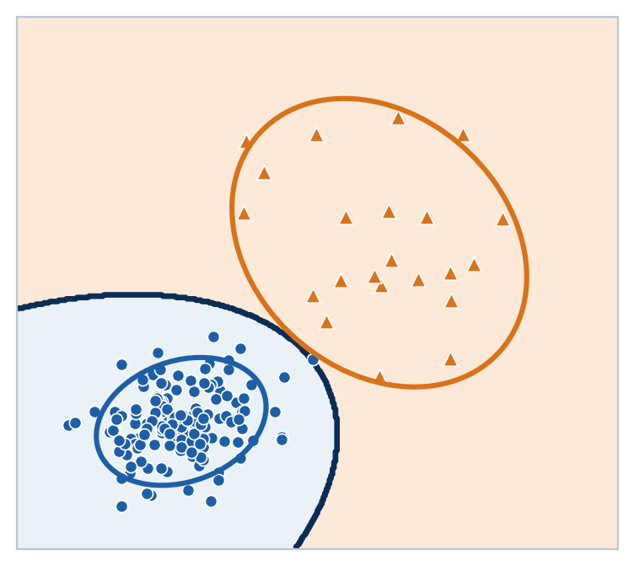
QDA: each class gets its own spread
When classes vary differently, the boundary bends.
δₖ(x) = −½ ln σₖ² − (x − μₖ)² / (2σₖ²) + ln πₖ
Balanced review queue (equal priors, so ln π cancels). Transaction amount x = $100.
Class | μ | σ² | Score at x = 100
Legit | 50 | 400 | −3.00 − 3.13 = −6.12
Fraud | 120 | 3,600 | −4.09 − 0.06 = −4.15
Higher score wins: fraud. $100 is unusual for a tight legit profile, ordinary for a wide fraud profile.
Its own spread per class → the boundary bends.
CS 471 | L26: ML Foundations
24
Notes:
TIMING: 2 min.
INSTRUCTOR: Look at the figure: legit transactions form a tight cluster (people are predictable); fraud is widely scattered. LDA forces both classes to share one spread; QDA lets each class have its own. Because the spreads no longer cancel, the boundary becomes a curve that wraps around the tight legit cluster.
Quick 1D example (a balanced review queue, so equal priors and the ln(pi) term is identical for both classes and cancels):
Legit: -0.5 ln(400) = -3.00; (100 - 50)^2 / (2 x 400) = 2500/800 = 3.13; score -6.12.
Fraud: -0.5 ln(3,600) = -4.09; (100 - 120)^2 / (2 x 3,600) = 400/7,200 = 0.06; score -4.15.
Higher (less negative) score wins: fraud. INTERPRET: $100 is 2.5 standard deviations from typical legit, but less than one from typical fraud.
Full calculation with the prior term, plus a second point, is on backup slide B1.
MILITARY/ENGINEERING EXAMPLE (verbal): Scheduled satellite downlinks arrive at tightly predictable times (small spread); anomalous contacts are scattered (large spread). QDA naturally draws a tight window around "normal."
SOURCE NOTE: James et al. (2023), ISL, p. 156.
ASSESSMENT ALIGNMENT: Objective 3 (LDA vs. QDA assumption and boundary). [Confirm whether QDA arithmetic is assessed; if so, teach B1 in class.]

Slide 25
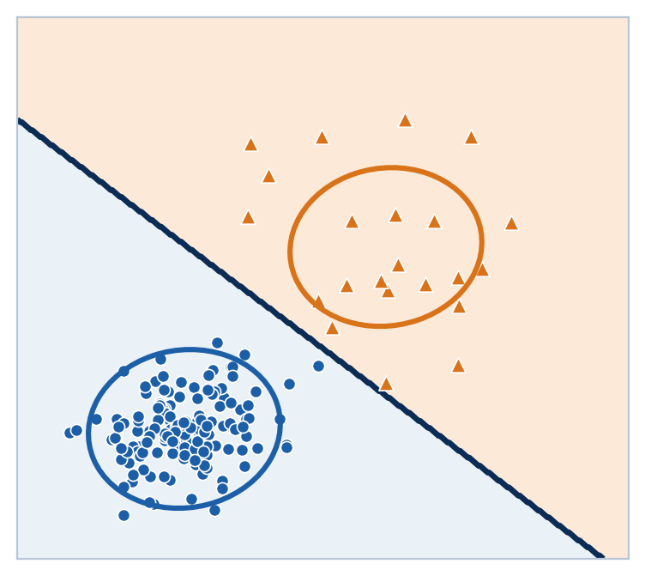
LDA vs. QDA is a bias-variance choice
More flexibility needs more data.
LDA
 | LDA | QDA
Spread | Shared by all classes | One per class
Boundary | Line | Curve
Parameters | Fewer | More
Lean | Higher bias | Higher variance
Best with | Smaller datasets | Larger datasets
QDA
More flexible boundary, more parameters, more data needed: the bias-variance tradeoff again.
CS 471 | L26: ML Foundations
25
Notes:
TIMING: 1 min. (First slide to cut if running long; state the takeaway verbally instead.)
INSTRUCTOR: Explicit callback to Part 2. QDA estimates a separate spread (covariance) for every class, which means many more parameters. With plenty of data it captures real curvature (lower bias). With little data those extra parameters are estimated noisily, and the boundary jumps around from sample to sample (higher variance). LDA's shared-spread assumption is "wrong" whenever classes truly differ, but it is stable. Rule of thumb from ISL: prefer LDA with small training sets; QDA when the training set is large or the shared-spread assumption is clearly false.
ASK: "Our fraud class has only about 200 examples out of 5,000. Which worries you more here?"
ASSESSMENT ALIGNMENT: Objective 1 and Objective 3 together (apply bias-variance reasoning to model choice). [Confirm against GR/quiz items when available.]

Slide 26
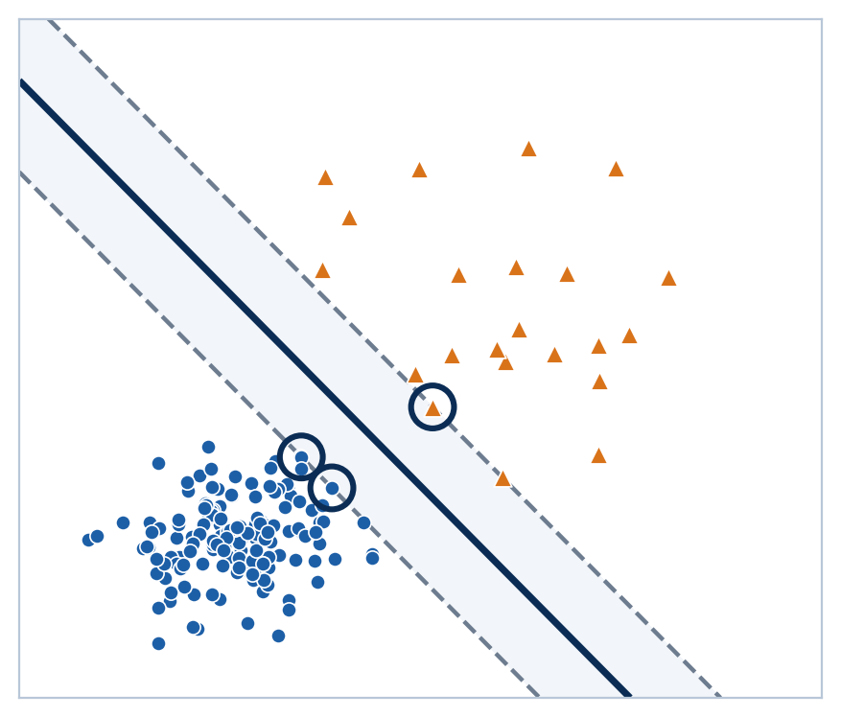
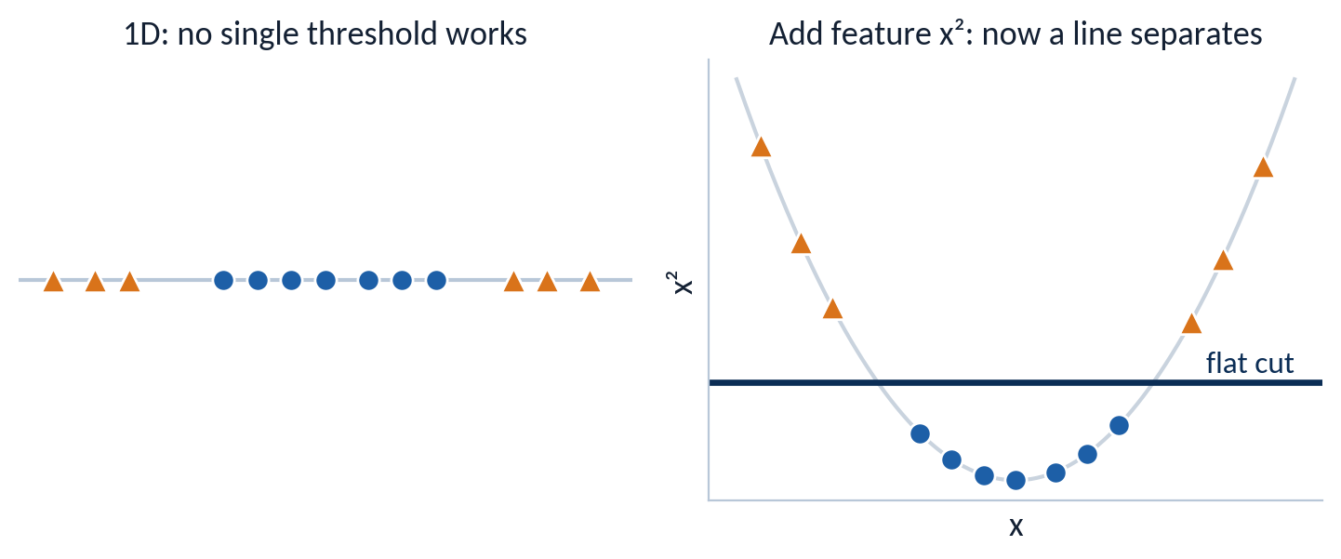
Support vector machines: the widest street
Only the points nearest the boundary decide where it goes.
Widest street
SVM picks the separating line with the largest margin between classes.
Support vectors (circled)
The only points that hold the boundary in place.
Kernel trick: add a feature so a line works.
CS 471 | L26: ML Foundations
26
Notes:
TIMING: 1.5 min.
INSTRUCTOR: Many straight lines separate the two groups in the figure. SVM picks the one with the widest "street" (margin) between the classes. The circled points sit on the edges of the street: these support vectors are the only points that determine the boundary. Every other point could move (without crossing the street) and nothing would change.
Kernel trick (bottom right): when no straight line works, add a transformed feature. In 1D, legit values sit in the middle and fraud at both extremes; no single threshold separates them. Add x-squared as a second feature and a flat line separates them. Kernels let SVM do this implicitly, even into very high-dimensional spaces, without computing the new features.
Real data is rarely perfectly separable; practical SVMs allow some points inside the street (soft margin). Mention only if asked; details on backup B3.
SOURCE NOTE: James et al. (2023), ISL, p. 367. Figure: fitted linear SVM on a separable subset of the running data.
ASSESSMENT ALIGNMENT: Objective 3; Knowledge Check Q2 (kernel SVM vs. logistic regression: a kernel SVM can draw non-linear boundaries, logistic regression on raw features cannot). [Confirm against GR/quiz items when available.]

Slide 27
Worked example: margin width
Compute → Interpret → Predict with margin = 2 / ‖w‖.
w = [0.6, 0.8]
‖w‖ = √(0.36 + 0.64) = 1
margin = 2 / 1 = 2
w = [6, 8]
‖w‖ = √(36 + 64) = 10
margin = 2 / 10 = 0.2
Interpret
Predict
Smaller weights mean a wider street: more room for slightly unusual new points, so better generalization.
Delete a point far from the street: nothing changes. Delete a support vector: the street can move.
CS 471 | L26: ML Foundations
27
Notes:
TIMING: 1.5 min.
INSTRUCTOR:
COMPUTE: For w = [0.6, 0.8]: ||w|| = sqrt(0.36 + 0.64) = sqrt(1) = 1, so margin = 2 / 1 = 2. For w = [6, 8]: ||w|| = sqrt(36 + 64) = sqrt(100) = 10, so margin = 2 / 10 = 0.2. Both vectors point in the same direction, so the boundary line has the same orientation; only the street width differs.
INTERPRET: Smaller weights mean a wider street. A wide margin leaves room for new points that are slightly unusual, which tends to generalize better. That is why SVM training minimizes ||w||.
PREDICT: Delete a point far from the street: nothing changes (it was not a support vector). Delete a support vector: the street can widen or shift.
ASSESSMENT ALIGNMENT: Objective 3 (compute margin from w; support vector reasoning). Original numbers. [Confirm against GR/quiz/homework items when available.]

Slide 28
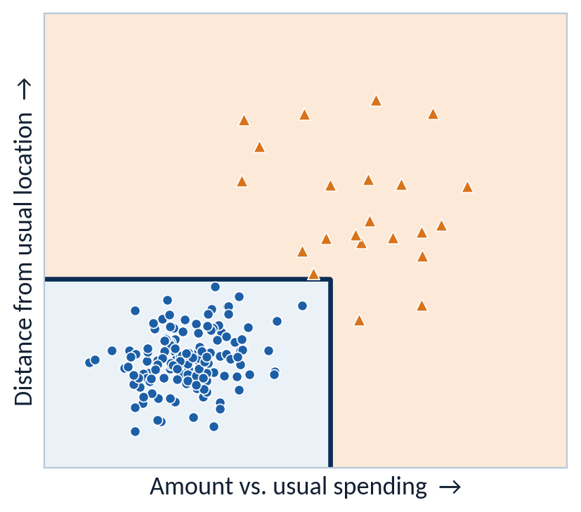
Decision trees: questions that carve the map
Each split asks one yes/no question about one feature.
Distance from usual location > 4.1?
no
yes
Amount vs. usual > 5.5?
FRAUD
no
yes
LEGIT
FRAUD
Gini = 1 − Σ pᵢ²
0 = pure node; higher = more mixed
CS 471 | L26: ML Foundations
28
Notes:
TIMING: 1.5 min.
INSTRUCTOR: A decision tree is a flowchart learned from data. The flowchart on the left is the actual depth-2 tree fitted to our fraud data, and the figure on the right shows what those two questions do to the feature space: every split is a vertical or horizontal cut, so the regions are rectangles. Trace one point through the flowchart and find its rectangle.
How does the tree choose each question? It tries candidate splits and keeps the one that leaves the purest groups, measured by Gini impurity: 0 means a node contains only one class; 0.5 is the most mixed possible with two classes.
NOTE: Feature values are on the plot's relative scale (0 to 10), not dollars or miles.
SOURCE NOTE: James et al. (2023), ISL, p. 331.
ASSESSMENT ALIGNMENT: Objective 3 (tree mechanism, Gini definition). [Confirm against GR/quiz/notebook items when available.]

Slide 29
Worked example: choose the first split
Pick the split that leaves the purest groups.
Root: 12 transactions ▲▲▲ ●●●●●●●●● Gini = 1 − (0.25² + 0.75²) = 0.375
Split A: “Amount > $500?”
Split B: “Foreign merchant?”
Yes: ▲▲▲ ●
Gini = 0.375
Yes: ▲▲ ●●●●
Gini = 0.444
No: ●●●●●●●●
Gini = 0
No: ▲ ●●●●●
Gini = 0.278
Weighted: (4/12)(0.375) + (8/12)(0) = 0.125
Weighted: (6/12)(0.444) + (6/12)(0.278) ≈ 0.361
Interpret
Predict
A cuts impurity 0.375 → 0.125; B only to 0.361. The tree asks A first.
Keep splitting until every leaf is pure → it memorizes the training data (overfit).
CS 471 | L26: ML Foundations
29
Notes:
TIMING: 2.5 min.
INSTRUCTOR:
ROOT: 12 transactions, 3 fraud and 9 legit. p = 0.25 and 0.75. Gini = 1 - (0.0625 + 0.5625) = 0.375.
SPLIT A ("Amount > $500?"): Yes branch has 4 (3 fraud, 1 legit): Gini = 1 - (0.5625 + 0.0625) = 0.375. No branch has 8 (all legit): Gini = 0. Weighted = (4/12)(0.375) + (8/12)(0) = 0.125.
SPLIT B ("Foreign merchant?"): Yes has 6 (2 fraud, 4 legit): 1 - (1/9 + 4/9) = 4/9, about 0.444. No has 6 (1 fraud, 5 legit): 1 - (1/36 + 25/36) = 10/36, about 0.278. Weighted = 0.5(0.444) + 0.5(0.278), about 0.361.
INTERPRET: A drops impurity from 0.375 to 0.125; B barely helps (to 0.361). The tree asks A first.
PREDICT: If the tree keeps splitting until every leaf has Gini 0, it will isolate individual training points: a memorized answer key, high variance (slide 8's right panel). That motivates the random forest.
WATCH FOR: Students averaging child Gini values without weighting by node size.
ASSESSMENT ALIGNMENT: Objective 3 (compute Gini and weighted impurity; choose a split). Original numbers. [Confirm against GR/quiz/homework items when available.]

Slide 30
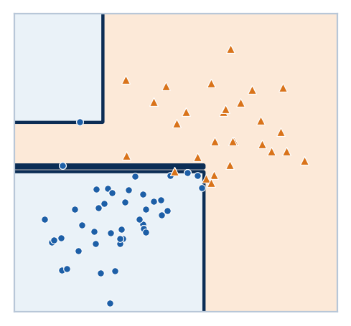
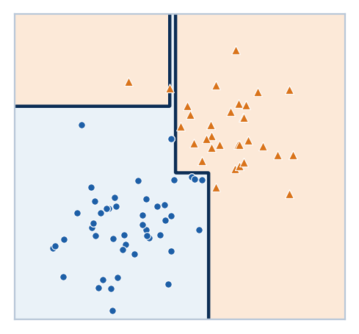
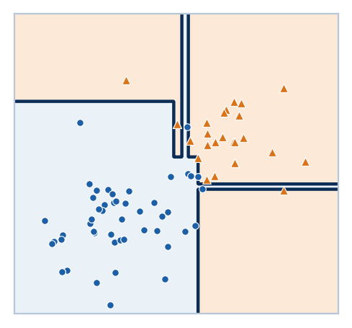
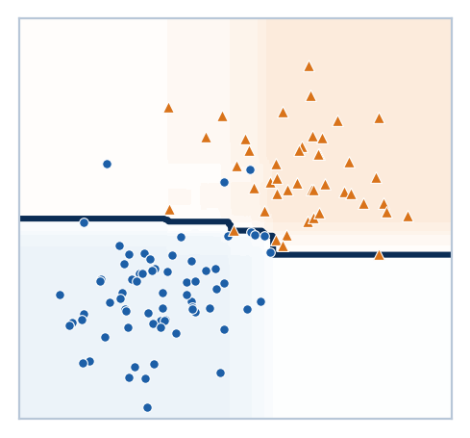
Random forests: many trees, one vote
Averaging many noisy trees cancels much of their variance.
Tree 1 (bootstrap 1)
Tree 2 (bootstrap 2)
Tree 3 (bootstrap 3)
Forest of 500 trees: vote share
How it works
Vote on one transaction
▲▲▲▲▲ ●●
5 of 7 trees say FRAUD → predict fraud (71%)
Each tree trains on a bootstrap sample of the rows and considers a random subset of features at each split. Then the trees vote.
Individual trees disagree (high variance). Their vote is far more stable.
CS 471 | L26: ML Foundations
30
Notes:
TIMING: 2.5 min.
INSTRUCTOR: The three left panels are real trees, each trained on a different bootstrap sample of the same data (rows drawn at random with replacement). Point out how different their boundaries are: that disagreement is the high variance of a single deep tree. The right panel is a forest of 500 such trees; shading shows the share of trees voting fraud, and the line is the majority-vote boundary. It is far more stable than any single tree.
Two sources of randomness: (1) each tree sees a bootstrap sample of rows (bagging = bootstrap aggregating); (2) at each split, each tree may only consider a random subset of features. The second one makes the trees disagree in different ways (decorrelates them), so their errors cancel when averaged.
Vote example: 7 trees, 5 say fraud, 2 say legit: predict fraud with 5/7, about 71%, of the vote.
CORRECTION TO THE READING: The reading describes forest trees as "shallow." In a standard random forest the individual trees are usually grown deep (low bias, high variance); averaging many decorrelated deep trees is what lowers variance while keeping bias low.
ASSESSMENT ALIGNMENT: Objective 3; Knowledge Check Q3 (how bagging reduces variance). [Confirm against GR/quiz/notebook items when available.]

Slide 31
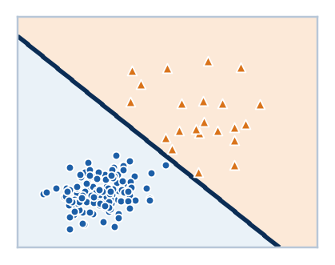
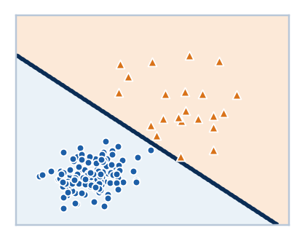
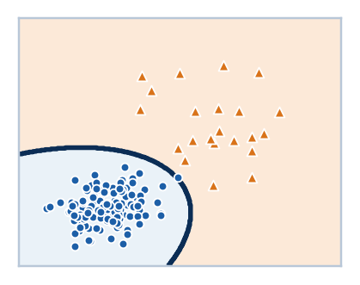
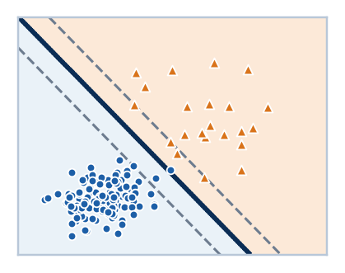
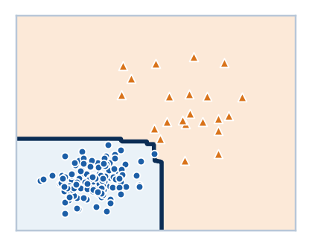
Same data, five boundaries
Choose by the shape of your data and the cost of your errors.
Model | Boundary | Key assumption | Boundary shape | Bias / variance lean
Logistic regression |  | Log-odds of fraud are a linear function of the features | Line (probability rises along an S-curve) | Higher bias, low variance
LDA |  | Each class is a bell curve; all classes share one spread | Line | Higher bias, low variance
QDA |  | Each class is a bell curve with its own spread | Curve | Lower bias, more variance
SVM |  | Only the points nearest the boundary matter | Widest-margin line (curved with a kernel) | Depends on kernel
Trees & random forests |  | Split with yes/no feature questions; forest votes over many trees | Axis-aligned steps | Tree: high variance; forest: much lower
CS 471 | L26: ML Foundations
31
Notes:
TIMING: 1.5 min.
INSTRUCTOR: Return to the slide 19 organizer, now complete, with each boundary fitted to the same fraud data. Read down the "boundary shape" column: line, line, curve, widest-margin line, steps. Then down the last column to connect every model to bias-variance.
Discussion prompt: "Our legit cluster is tight and fraud is spread out. Which rows would you try first, and what would you check before trusting it?" Good answers: QDA or a forest (the data is curved), then confirm on the held-out test set with recall and precision, not accuracy.
Knowledge Check Q2 answer in this language: a kernel SVM can draw curved boundaries for non-linear radar or fraud profiles, while logistic regression on the raw features can only draw a line.
ASSESSMENT ALIGNMENT: Objective 3 (compare model families by assumption and boundary). [Confirm against GR/quiz/notebook items when available.]

Slide 32
Diagnose the claim
Correct or incorrect? Be ready to fix the incorrect ones.
A fraud model with 97% accuracy is always good fraud model.
1
Correct
Incorrect
LDA draws curved decision boundaries.
2
Correct
Incorrect
A larger ‖w‖ gives an SVM a wider margin.
3
Margin = 2 / ||w||
Correct
Incorrect
A random forest reduces variance by averaging many trees.
4
Correct
Incorrect
Scoring a model on its training data measures generalization.
5
Correct
Incorrect
CS 471 | L26: ML Foundations
32
Notes:
TIMING: 2 min (synthesis total 4 min). Pairs vote, then discuss.
ANSWERS:
1. Incorrect. On imbalanced data accuracy can hide a useless model (the lazy model scored 96%). Check recall and precision.
2. Incorrect. LDA assumes a shared spread, which produces a straight boundary. QDA draws curves.
3. Incorrect. Margin = 2 / ||w||, so a larger ||w|| means a NARROWER margin.
4. Correct. Averaging many decorrelated trees (bagging plus random feature subsets) reduces variance.
5. Incorrect. Scoring on training data measures memorization. Generalization is measured on the held-out test set.
WATCH FOR: Claim 3 is the most commonly missed; claim 1 checks whether the Part 3 lesson stuck.
ASSESSMENT ALIGNMENT: Objectives 1-3 (misconception check). [Confirm against GR/quiz items when available.]

Slide 33
Exit ticket: design the model
Put the whole pipeline together.
A maintenance team wants to flag drone motors likely to fail before the next sortie. Failures are rare (about 3% of motors). A missed failure can lose the aircraft; a false alarm costs a two-hour inspection.
1
2
3
Which metric do you prioritize, and why?
How will you check that the model generalizes?
Which model family would you try first? Justify with boundary shape and data size.
Recall is most important here – why?
Many possible answers: Log Reg interpretable baseline; Random Forrest if the relationship looks non-linear and there is enough data; LDA over QDA if failure examples are scarce (fewer parameters, lower variance).
CS 471 | L26: ML Foundations
33
Notes:
TIMING: 2 min (collect on paper or in Blackboard).
STRONG ANSWERS:
1. Recall (with precision reported alongside). A missed failure can lose an aircraft; a false alarm costs two hours. Accuracy would be misleading because failures are only about 3%.
2. Hold out a test set the model never sees during training (and a validation set for any tuning). Compare train vs. test performance; a large gap means overfitting.
3. Any justified choice. Examples: logistic regression first as a simple, interpretable baseline; a random forest if the relationship looks non-linear and there is enough data; LDA over QDA if failure examples are scarce (fewer parameters, lower variance).
GRADING NOTE: Credit the justification, not the specific model.
CLOSE: Restate the central claim on the slide.
ASSESSMENT ALIGNMENT: Objectives 1-3 integrated (performance target). [Map to GR/quiz/homework items when available.]

Slide 34
Backup B1: QDA calculation in full
Include the prior term, then test a second point and a realistic prior.
Case | Legit score | Fraud score | Decision
x = 100, equal priors | −3.00 − 3.13 − 0.69 = −6.81 | −4.09 − 0.06 − 0.69 = −4.84 | Fraud
x = 20, equal priors | −3.00 − 1.13 − 0.69 = −4.81 | −4.09 − 1.39 − 0.69 = −6.17 | Legit
x = 100, 4% fraud prior | −6.12 + ln 0.96 = −6.16 | −4.15 + ln 0.04 = −7.37 | Legit
Legit: μ = 50, σ² = 400. Fraud: μ = 120, σ² = 3,600.
δₖ(x) = −½ ln σₖ² − (x − μₖ)² / (2σₖ²) + ln πₖ
Including a realistic 4% prior flips the $100 transaction back to legit.
CS 471 | L26: ML Foundations
34
Notes:
USE: If QDA arithmetic is assessed, teach this in place of the brief version on slide 24 (adds about 3 minutes; cut slide 25 to compensate).
WORKED:
Equal priors, ln(0.5) is about -0.69 for both classes.
x = 100: Legit = -3.00 - 3.13 - 0.69 = -6.81. Fraud = -4.09 - 0.06 - 0.69 = -4.84. Fraud wins (same decision as slide 24; the equal prior term only shifts both scores).
x = 20: Legit = -3.00 - (30^2 / 800 = 1.13) - 0.69 = -4.81. Fraud = -4.09 - (100^2 / 7,200 = 1.39) - 0.69 = -6.17. Legit wins.
Realistic prior (4% fraud) at x = 100: ln(0.96) is about -0.04 and ln(0.04) is about -3.22. Legit = -6.12 - 0.04 = -6.16. Fraud = -4.15 - 3.22 = -7.37. Legit wins: the same point flips once the rare-class prior is included (same lesson as the LDA base-rate example).
ASSESSMENT ALIGNMENT: Objective 3 (QDA discriminant computation). [Confirm whether assessed.]

Slide 35
Backup B2: QDA with many features
The same idea with vectors and covariance matrices.
δₖ(x) = −½ log |Σₖ| − ½ (x − μₖ)ᵀ Σₖ⁻¹ (x − μₖ) + log πₖ
Σₖ
Covariance matrix for class k: its spread and correlations
(x − μₖ)ᵀ Σₖ⁻¹ (x − μₖ)
Distance from the class center, measured in that class’s own spread
log |Σₖ|
Penalty for a class that is spread out everywhere
Shared Σ for all classes
Quadratic terms cancel, leaving a line: this is LDA
CS 471 | L26: ML Foundations
35
Notes:
USE: Only for students who ask how QDA works with more than one feature, or for Data Science majors who want the general form.
EXPLAIN: The 1D formula generalizes by replacing the variance with a covariance matrix Sigma-k (spread and correlation for each class), and the squared distance with the Mahalanobis distance (x - mu)^T Sigma^-1 (x - mu). log|Sigma-k| penalizes classes with large spread. If every class shared the same Sigma, the quadratic terms would cancel between classes and the boundary would be linear: that is exactly LDA.
SOURCE NOTE: James et al. (2023), ISL, p. 156.
ASSESSMENT ALIGNMENT: Enrichment; not expected to be assessed. [Confirm.]

Slide 36
Backup B3: kernels and soft margins
How SVMs bend the boundary without building the new features.
RBF kernel
K(x, x′) = exp(−γ ‖x − x′‖²)
Similarity that fades with distance. Large γ = very local = wiggly boundary (high variance).
Recall slide 8: the overfit panel was an RBF SVM with a very large γ.
Soft margin (C)
Real data overlaps, so some points may sit inside the street.
Large C: few violations, more variance. Small C: wider street, more bias.
CS 471 | L26: ML Foundations
36
Notes:
USE: For students asking how kernels work, or to connect SVM back to the bias-variance tradeoff.
EXPLAIN: A kernel K(x, x') measures similarity between two points as if they had been mapped into a richer feature space, without computing that mapping. The RBF kernel's gamma controls how local that similarity is: large gamma lets every training point carve out its own small region, which is exactly the overfit panel on slide 8 (it was an RBF SVM with a very large gamma). Soft margin: real data overlaps, so SVMs allow some points inside the street; the cost parameter C controls how heavily violations are penalized. Large C means few violations tolerated (more flexible, higher variance); small C means a wider, more forgiving street (higher bias).
ASSESSMENT ALIGNMENT: Enrichment; supports Knowledge Check Q2 depth. [Confirm.]

